Slide 1





Spring Data Advanced Querying
Query Methods, JPQL
Advanced Repositories
Spring Configuration
Databases
Frameworks
SoftUni Team
Technical Trainers
Software University
http://softuni.bg

Slide 2
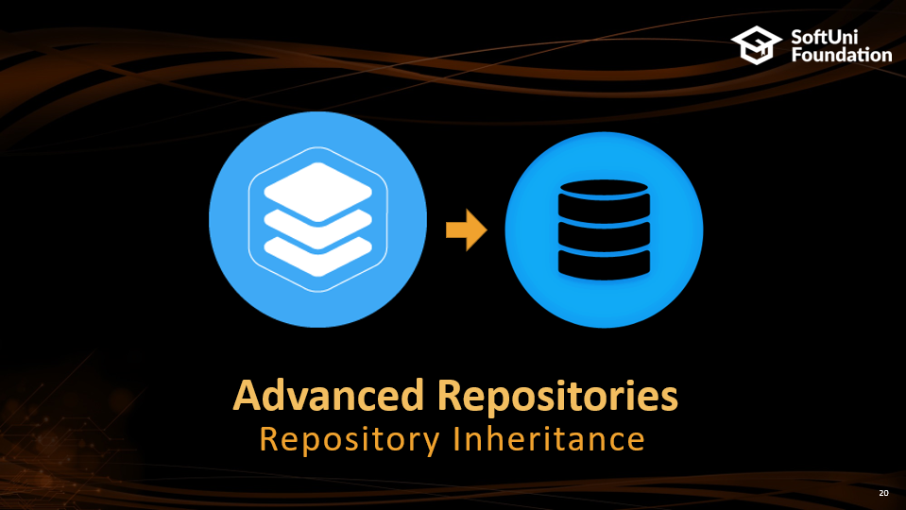
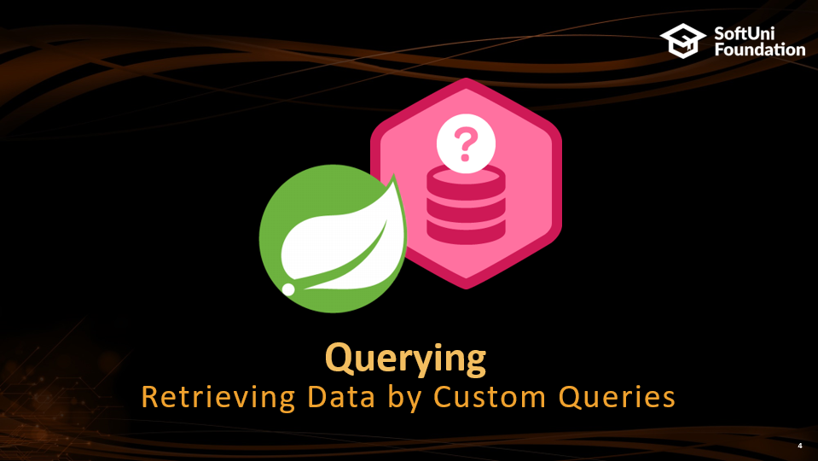
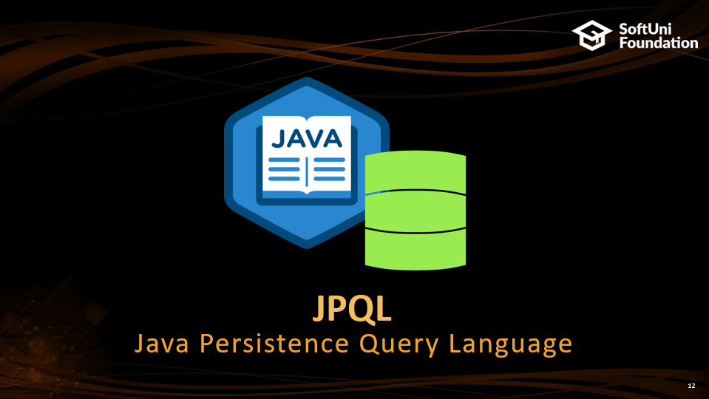


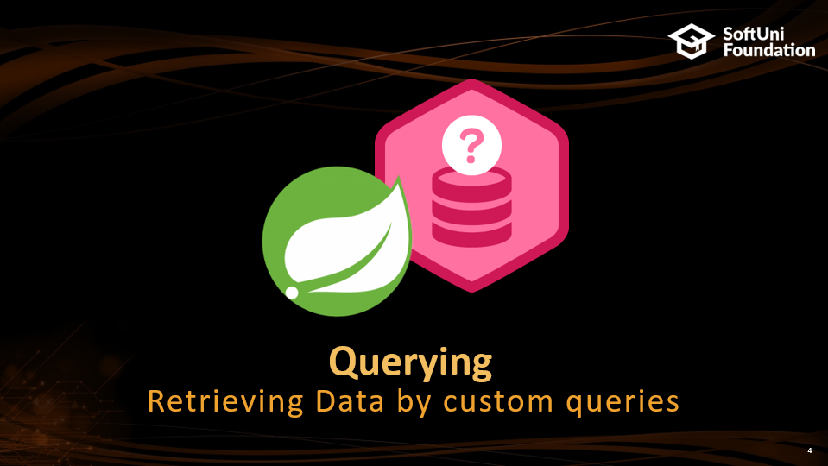


Table of Contents

Slide 3
Questions
sli.do #JavaDB

Slide 4

Querying
Retrieving Data by Custom Queries

Slide 5
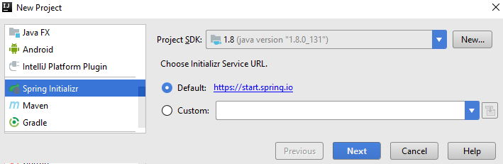
Spring Project

Slide 6
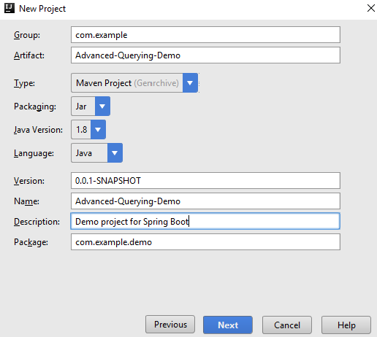
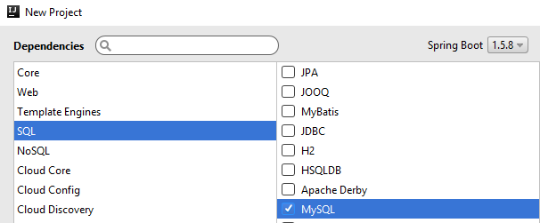
Spring Project (2)

Slide 7
Query methods
ShampooRepository.java
@Repository
public interface BasicShampooDao extends JpaRepository<BasicShampoo, Long> {
List<BasicShampoo> findByBrand(String brand);
}
Query method
Paramater
The method translates
to the following query:
SQL
SELECT *
FROM shampoos AS s
WHERE s.brand = ?
Paramater

Slide 8
Query Lookup
Query Prefix
Field
List<BasicShampoo> findByBrand(String brand);
Return Type
Query Prefix
Field
Field
List<BasicShampoo> findByBrandAndSize (String brand, Size size);
Predicate Keyword

Slide 9
Query methods
ShampooRepository.java
@Repository
public interface BasicShampooDao extends JpaRepository<BasicShampoo, Long> {
List<BasicShampoo> findByBrandAndSize(String brand, Size size);
}
Query method
Paramater
Paramater
SQL
SELECT *
FROM shampoos AS s
WHERE s.brand = ?
AND s.size = ?

Slide 10
Problem: Select Shampoos by Size
Write a method that selects all shampoos by input size
Order the result by shampoo id
Example input-output:
MEDIUM
Nature Moments Mediterranean Olive Oil & Aloe Vera MEDIUM 6.50lv.
Volume & Fullness Lavender MEDIUM 5.50lv.
Rose Shine & Hydration MEDIUM 6.50lv.
Color Protection & Radiance MEDIUM 6.75lv.
…

Slide 11
Solution: Select Shampoos by Size
ShampooRepository.java
@Repository
public interface ShampooRepository extends CrudRepository<BasicShampoo, Long> {
List<BasicShampoo> getAllBySizeOrderById(Size sizeValue);

Slide 12


JPQL
Java Persistence Query Language

Slide 13
JPQL
Object-oriented query language
Part of the Java Persistence API
Used to make queries against entities stored in a relational database
SQL syntax operating with entities, not tables in the data source

Slide 14
JPQL Functionalities
JPQL
SELECT
DELETE
UPDATE

Slide 15
JPQL Select Syntax
Entity Class
Field
"SELECT b FROM BasicIngredient AS b WHERE b.name IN :names"
Object
Aalias
Parameter

Slide 16
JPQL Join Syntax
Object
Class
"SELECT s
FROM BasicShampoo AS s
INNER JOIN s.batch AS b
WHERE b.batchDate < :batchDate"
Join
Field
Paramater

Slide 17
JPQL Syntax
Update:
Delete:
"UPDATE BasicIngredient AS b
SET b.price = b.price*1.10
WHERE b.name IN :names"
Parameter
"DELETE FROM BasicIngredient AS b
WHERE b.name = :name"

Slide 18
Problem: Select Shampoos by Ingredients
Write a method that selects all shampoos with ingredients in a given list
Example input-output:
Berry
Mineral-Colagen
Color Protection & Radiance
Fresh it Up!
Nectar Nutrition
Superfruit Nutrition
Color Protection & Radiance
Nectar Nutrition
…

Slide 19
Solution: Select Shampoos by Ingredients
ShampooRepository.java
@Repository
public interface BasicIngredientDao extends JpaRepository<BasicIngredient, Long>{
@Query(value = "select s from BasicShampoo s " +
"join s.ingredients i where i in :ingredients")
List<BasicShampoo> findByIngredientsIn(@Param(value = "ingredients") Set<BasicIngredient> ingredients);
}

Slide 20


Advanced Repositories
Repository Inheritance

Slide 21
Repository Inheritance
In bigger applications we have similar entities extending an abstract class
Their base attributes and actions towards them are the same regardless differences
We can set up a base repository to reduce query and code duplication
It can be inherited to clear up specifics

Slide 22
Example: Repository Inheritance
IngredientRepository.java
Not a repository
@NoRepositoryBean
public interface IngredientRepository<T extends Ingredient> extends JpaRepository<T, Long>{
//…
}
ChemicalIngredientRepository.java
@Repository
public interface ChemicalIngredientRepository extends IngredientRepository <BasicChemicalIngredient> {
List<ChemicalIngredient> findByChemicalFormula(String chemicalFormula);
}

Slide 23
Example: Repository Inheritance
CustomShampooRepository.java
public interface CustomShampooRepository {
void create(BasicShampoo basicShampoo);
}
CustomShampooRepositoryImpl.java
public class CustomShampooDaoImpl implements CustomShampooRepository {
@PersistenceContext
private EntityManager entityManager;
@Transactional
public void create(BasicShampoo basicShampoo){
entityManager.persist(basicShampoo);
}
}
Inject
Entity Manager
Single Transaction

Slide 24

Spring Custom Configuration
Java-Based Setup

Slide 25
Application Properties
So far we've configured our project with a spring properties file:
application.properties
#Data Source Properties
spring.datasource.driverClassName = com.mysql.jdbc.Driver
spring.datasource.url = jdbc:mysql://localhost:3306/neck_and_elbow?useSSL=false&createDatabaseIfNotExist=true
spring.datasource.username = root
spring.datasource.password = 1234
Connection properties

Slide 26
Java-Based Configuration
Configuration
Class
JavaConfig.java
Repositories
Directory
@Configuration
@EnableJpaRepositories(basePackages = "com.neckandelbows.dao")
@EnableTransactionManagement
@PropertySource(value = "application.properties" )
public class JavaConfig {
//Add configuration
}
Property File

Slide 27
Java-Based Configuration
JavaConfig.java
@Autowired
private Environment environment;
@Bean
public DataSource dataSource() {
DriverManagerDataSource driverManagerDataSource = new DriverManagerDataSource(); driverManagerDataSource.setDriverClassName(environment.getProperty("spring.datasource.driverClassName"));
driverManagerDataSource.setUrl(environment.getProperty("spring.datasource.url"));
driverManagerDataSource.setUsername(environment.getProperty("spring.datasource.username"));
driverManagerDataSource.setPassword(environment.getProperty("spring.datasource.password"));
return driverManagerDataSource;
}
Data Source Connection

Slide 28
Java-Based Configuration
JavaConfig.java
@Bean
public EntityManagerFactory entityManagerFactory() {
HibernateJpaVendorAdapter vendorAdapter = new HibernateJpaVendorAdapter();
vendorAdapter.setDatabase(Database.MYSQL);
vendorAdapter.setGenerateDdl(true);
vendorAdapter.setShowSql(true);
LocalContainerEntityManagerFactoryBean factory = new LocalContainerEntityManagerFactoryBean();
factory.setJpaVendorAdapter(vendorAdapter);
factory.setPackagesToScan("com.neckandelbows.domain");
factory.setDataSource(dataSource());
Properties jpaProperties = new Properties();
jpaProperties.setProperty("hibernate.hbm2ddl.auto","validate");
jpaProperties.setProperty("hibernate.format_sql", "true");
factory.setJpaProperties(jpaProperties);
factory.afterPropertiesSet();
return factory.getObject();
}
JPA Configuration
Models Package

Slide 29
Java-Based Configuration
JavaConfig.java
@Bean
public PlatformTransactionManager transactionManager() {
JpaTransactionManager txManager = new JpaTransactionManager();
txManager.setEntityManagerFactory(entityManagerFactory());
return txManager;
}
Transaction Manager Configuration

Slide 30
Java-Based Configuration
JavaConfig.java
@Configuration
@EnableJpaRepositories(basePackages = "com.neckandelbows.dao")
@EnableTransactionManagement
@PropertySource(value = "application.properties" )
public class JavaConfig {
//Add configuration
@Bean
public CustomShampooDaoImpl shampooDaoImpl(){
return new CustomShampooDaoImpl();
}
}
Bean Definition

Slide 31

Summary
Spring Data translates methods to SQL Queries
We can write custom queries
JPQL syntax on entity classes
Repositories can be inherited
Reduces code duplication for
inherited entities

Slide 32







Spring Data Advanced Querying
https://softuni.bg/courses/databases-advanced-hibernate

Slide 33
License
This course (slides, examples, demos, videos, homework, etc.) is licensed under the "Creative Commons Attribution-NonCommercial-ShareAlike 4.0 International" license
Attribution: this work may contain portions from
"Databases" course by Telerik Academy under CC-BY-NC-SA license

Slide 34




Free Trainings @ Software University
Software University Foundation – softuni.org
Software University – High-Quality Education, Profession and Job for Software Developers
softuni.bg
Software University @ Facebook
facebook.com/SoftwareUniversity
Software University Forums
forum.softuni.bg

